Slide 1
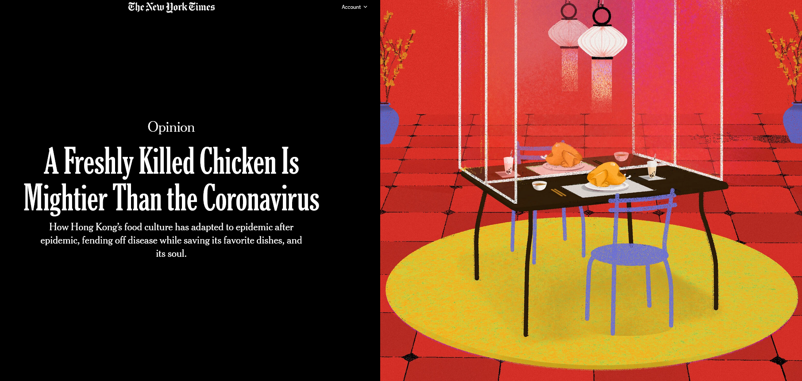
Reading/Questions 5
Notes:
“The power of food” https://www.nytimes.com/2020/09/10/opinion/coronavirus-hong-kong-food.html

Slide 2
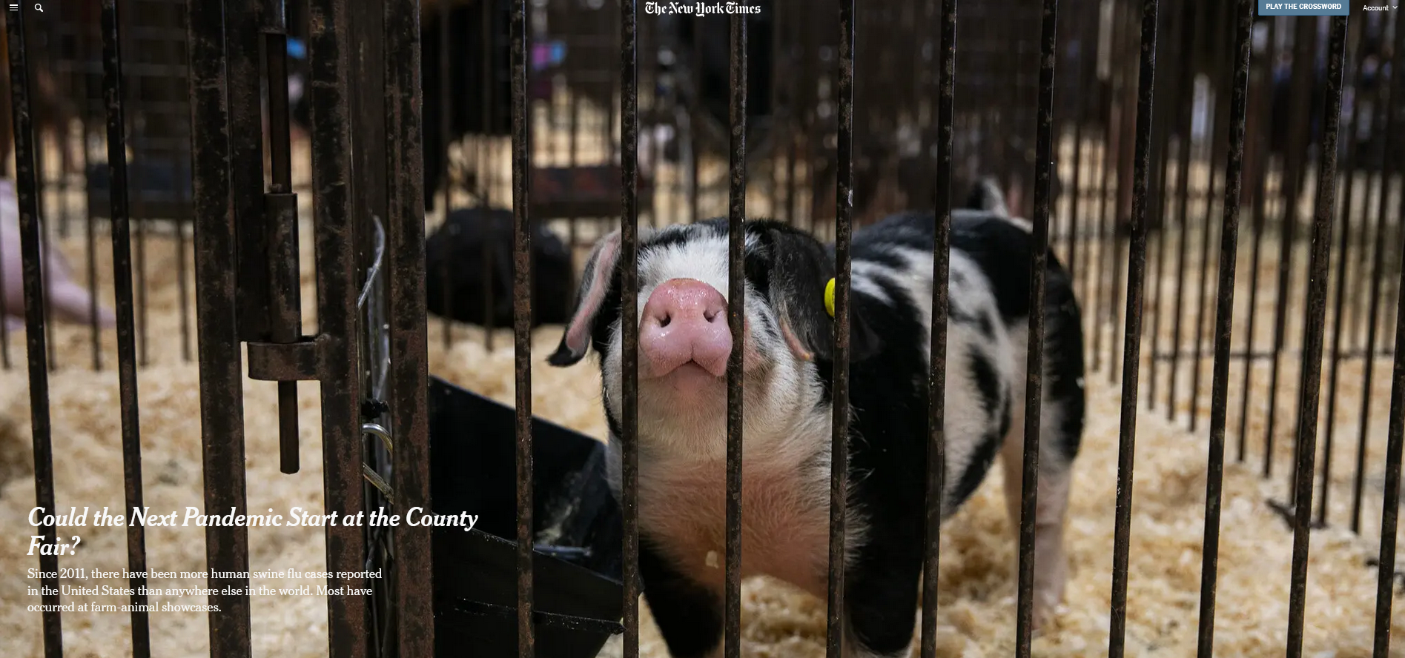
Reading/Questions 5
Notes:
https://www.nytimes.com/2023/07/25/health/swine-flu-pigs-agriculture.html

Slide 3
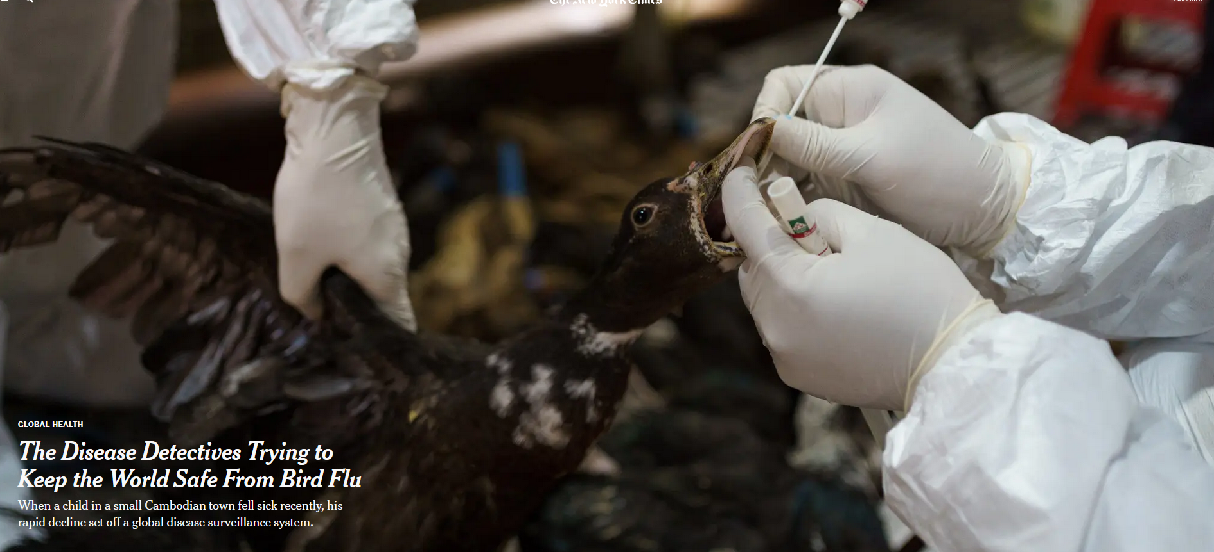
Reading/Questions 5

Slide 4
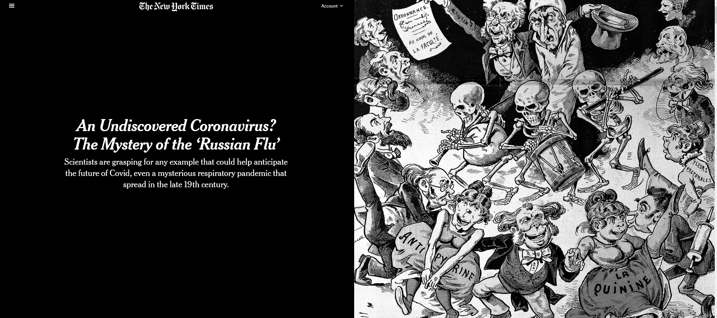
Reading/Questions 5
Notes:
https://www.nytimes.com/2022/02/14/health/russian-flu-coronavirus.html

Slide 5
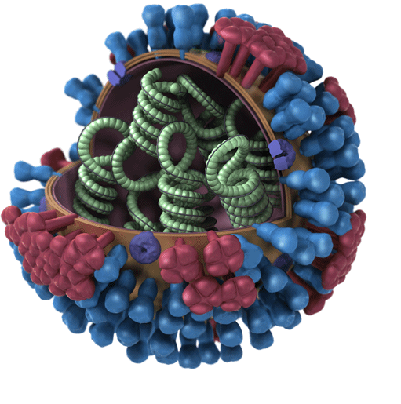
Influenza
Spreads via aerosols from human-to-human, animal- to-human, and human-to-animal contact
Fewer than half of Americans get a flu shot each season
When the vaccine is similar to circulating flu viruses, vaccinations reduce risk of going to doctor by 40-60%.
No cure, only vaccines that lessen severity of the flu and drugs that can slow viral replication
Notes:
The flu is everywhere. It is in all countries, but at different times and seasons.
Image is a flu virus. Like Covid, the influenza virus is an RNA virus. It has RNA as its genome instead of DNA. Some viruses have RNA, some have DNA.

Slide 6
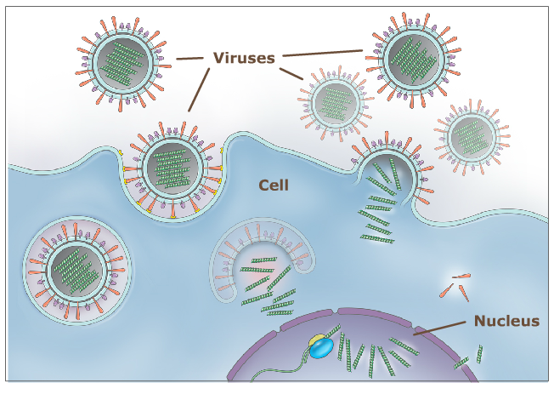
How the influenza virus works
Virus contains RNA
Virus enters outermost layer of cells in respiratory tract of infected host
RNA inserted into nucleus
Polymerases in nucleus used to make copies of viral RNA
These copies of RNA leave the cells to infect another person
Notes:
Every virus is a bunch of genes wrapped in a coat of proteins. In viruses, the genes can be made of DNA or RNA.

Slide 7
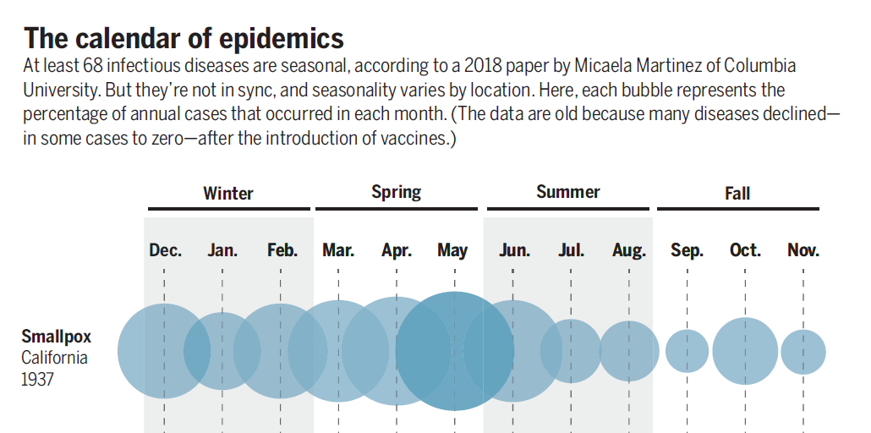
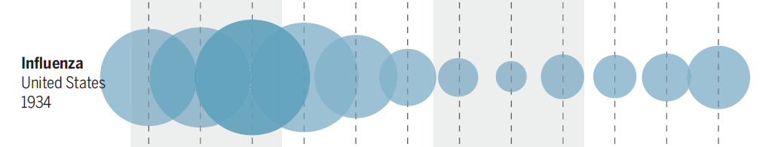
Influenza seasonality
Winter outbreaks of flu occur because:
Closer contact among humans in winter
Drying of respiratory tract cells due to warm heated air aids attachment and reproduction of virus
Drops in humidity have been associated with onset of flu season
.
Notes:
Participants in a morning versus an afternoon flu vaccine program had significantly higher antibody responses to two of three flu strains in the vaccine
There’s evidence of seasonal variation in the actions of human immune genes as well. In a massive analysis of blood and tissue samples from more than 10,000 people in Europe, the United States, Gambia, and Australia, researchers at the University of Cambridge found some 4000 genes related to immune function that had “seasonal expression profiles.” In one German cohort, expression in white blood cells of nearly one in four genes in the entire genome differed by the seasons. Genes in the Northern Hemisphere tended to switch on when they were switched off south of the equator, and vice versa.
https://www.sciencemag.org/news/2020/03/why-do-dozens-diseases-wax-and-wane-seasons-and-will-covid-19
Cohen, Jon. "Sick time." (2020): 1294-1297.
https://science.sciencemag.org/content/367/6484/1294.summary

Slide 8
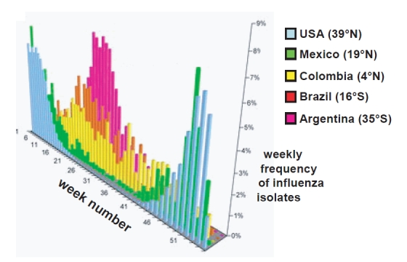
Vaccinations have to be customized
Dominance of A and B flu types vary from country to country
Countries and regions differ in when seasonal influenza occurs
Northern hemisphere: Oct – Feb
Southern hemisphere May to Sept
Equatorial areas: year-round flu season
Notes:
Lowen, Anice; Palese, Peter. (2009). Transmission of influenza virus in temperate zones is predominantly by aerosol, in the tropics by contact: A hypothesis. PLoS Currents Influenza

Slide 9
Influenza vaccines
Flu vaccination is a preventative stimulation of your body to produce antibodies to a particular combination of influenza virus A (IVA) and influenza virus B (IBV) predicted to be abundant during flu season.
For healthy adults, annual trivalent or quadrivalent influenza vaccines have been the major prophylactic prevention mechanism for several decades.
Decisions on vaccines made months in advance (Feb 2024 for our upcoming flu season)
Notes:
https://www.cdc.gov/flu/season/flu-season-2019-2020.htm

Slide 10
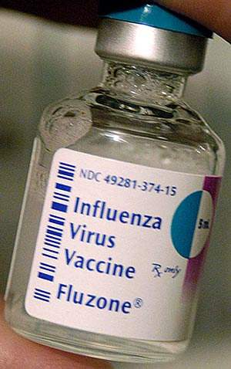
Vaccination rates remain low globally: around 40% in US and Europe, 5-10% or less in many other parts of the world
Effectiveness of vaccine can vary from year to year and for age groups
Influenza A ranged from 27-46% for adults and 46-59% for children, while for influenza B, 64-89% for children and around 60-78% for adults.
Globally, 30 bulk manufacturers of influenza vaccine produce 1.2 billion doses with only a six-month head start.
Most of the demand is in 16 high and middle income countries
Notes:
An impressive feat of biologic manufacturing something for which Big Pharma gets little credit.
Sanofi Pasteur is the world's largest manufacturer of influenza (flu) vaccines
The production and distribution process for a new vaccine takes about six months, however, during which time the circulating strains may shape-shift again. If the vaccines end up matching a given season’s viruses closely, they are up to 60 percent effective at preventing illness, the C.D.C. estimates; when they don’t, their effectiveness has been as low as 10 percent.

Slide 11
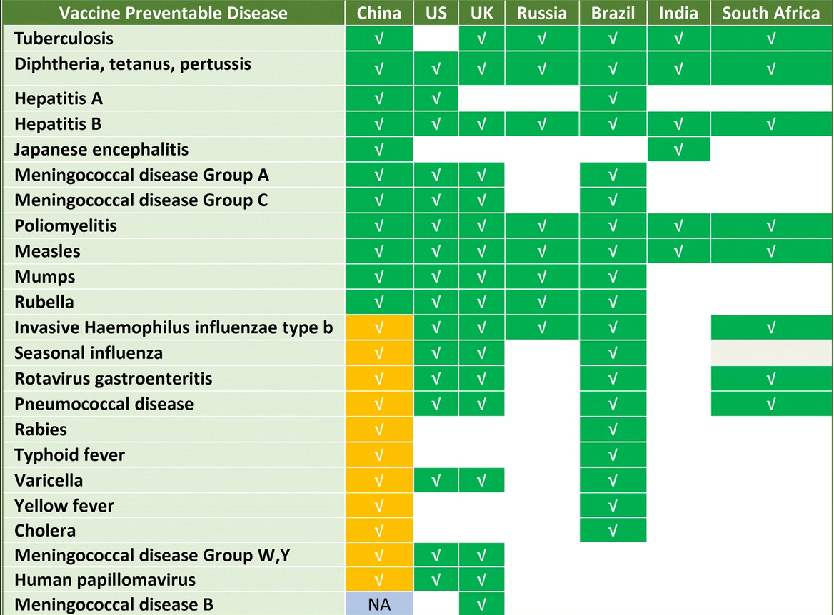
Flu vaccination coverage is not uniform globally
Green indicates vaccines made available through public health funding at low or no cost to public.
Yellow indicates vaccines available only thru private doctors, often at higher cost than vaccines provided to the public coverage
Notes:
Zheng, Y., Rodewald, L., Yang, J., Qin, Y., Pang, M., Feng, L., & Yu, H. (2018). The landscape of vaccines in China: history, classification, supply, and price. BMC Infectious Diseases, 18(1), 1-8. https://doi.org/10.1186/s12879-018-3422-0
Vaccine Preventable Diseases (VPDs) for national immunization program vaccines in China, US, UK, Russia, Brazil, India and South Africa. VPDs indicated with green are EPI vaccines in the respective countries. Gold indicates diseases prevented by national programs in the UK, US, Russia, or Brazil’s NIP but whose vaccines are not included in China’s EPI system.

Slide 12
Kentucky in the 1918 H1N1 pandemic
Nearly 15,000 people died statewide (as of Sept 17, 2022, 16,822 people have died of Covid in Kentucky)
On October 7, 1918, the state health board ordered that all places of amusement, all schools, and all churches throughout the state be closed until further notice
Kentuckians were urged to remain at home and refrain from traveling, paying social calls, entertaining friends, or attending weddings and funerals.
Most of the state’s colleges and universities also canceled classes and athletic activities.
Notes:
https://www.kentucky.com/opinion/linda-blackford/article241557031.html?

Slide 13
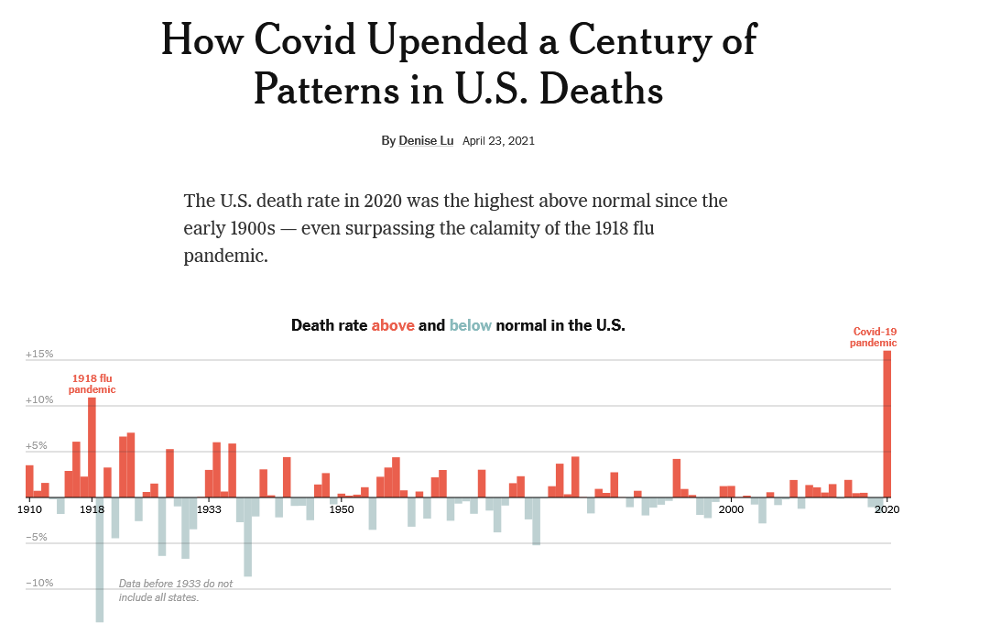
Higher than average death rate in 2020 is attributed to long period in which death rate declined due to better public health and medicine.
Death rate from H1N1 in 1918 was twice that of SARS-CoV-2
6.4 deaths per 1000 people for 1918
3.5 deaths per 1000 people for SARS-CoV2
Notes:
Overall higher death rate (from all causes) in 2020 is attributed to long period in which death rate declined due to better public health and medicine. The average was quite low and so when 2020 rolled around, it really stood out. The death rate from influenza was about double that of Covid
Population in US
1918 – 105 million
2021 – 331 million
Deaths
675,000 – 1918 flu
1,150,000 – Covid to date

Slide 14
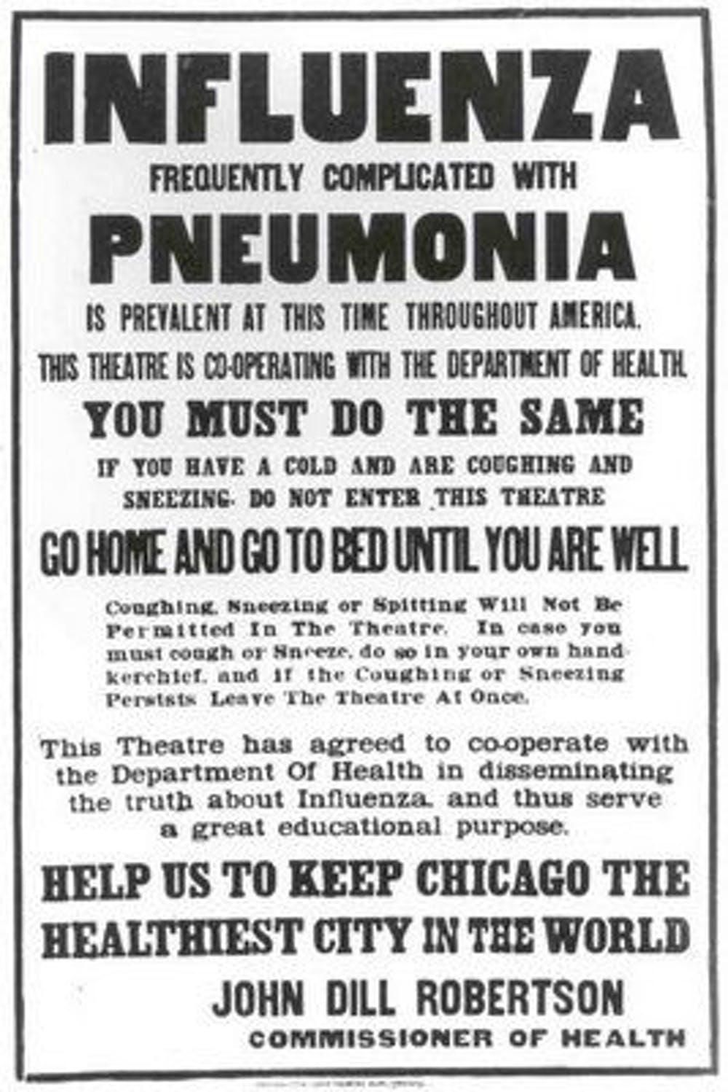
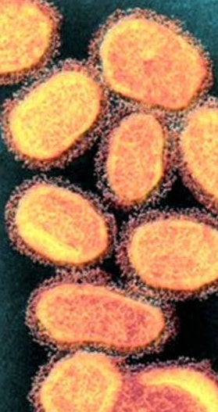
Arose from reassortment events among flu viruses circulating in humans and swine and an avian virus
1918 H1N1 genome has been sequenced from tissue samples of people who died during pandemic and were buried in cold, dry climates
Molecular properties for its pathogenicity in humans have been identified
These ‘virulence markers’ can be compared to new A influenza viruses in order to assess their pandemic potential

Slide 15
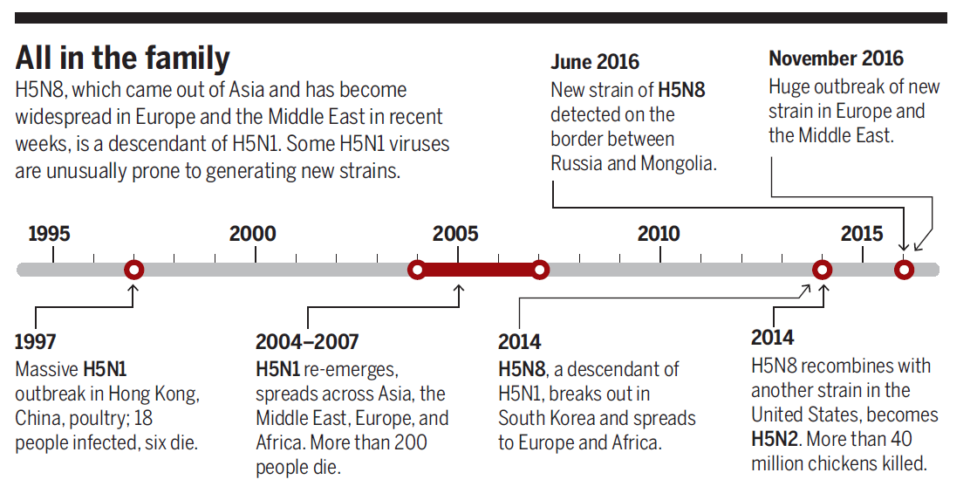
H5N1 has pandemic potential

Slide 16
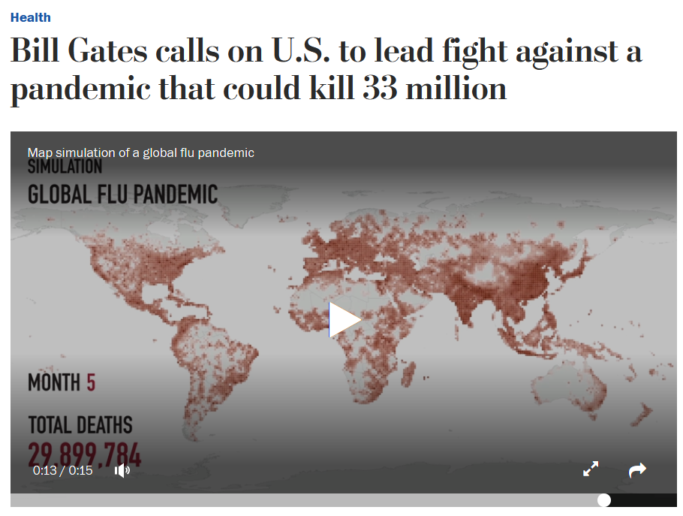
Another global influenza pandemic like 1918 is considered a likely occurrence – H5N1 has the potential
Worst case scenario: a human B flu virus and an avian flu A virus like H5N1 in same individual human
This could allow the pathogenicity of avian flu to acquire the ability to be spread via human-to-human contacts seen in B flu viruses
Notes:
https://www.washingtonpost.com/news/to-your-health/wp/2018/04/27/bill-gates-calls-on-u-s-to-lead-fight-against-a-pandemic-that-could-kill-millions A virus as deadly as the 1918 Spanish flu could kill up to 33 million people today

Slide 17
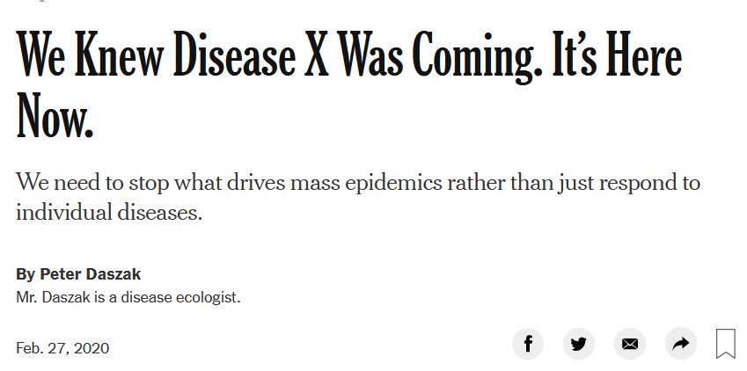
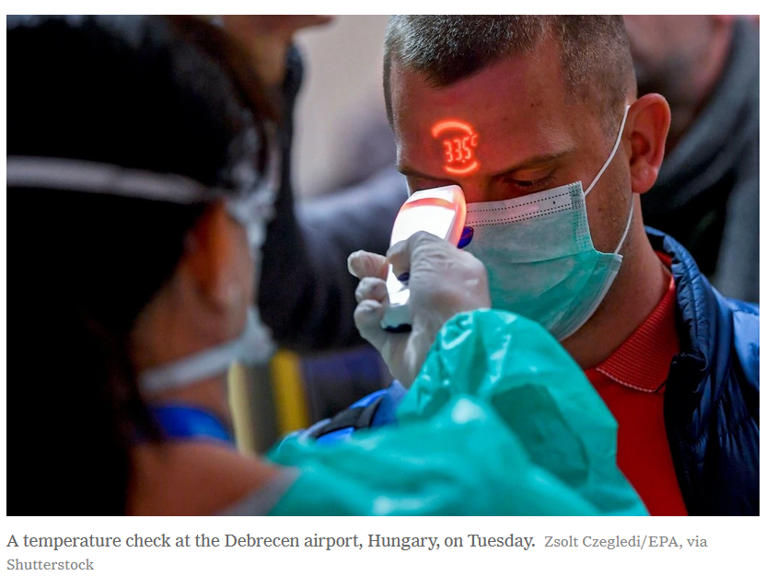
Another global pandemic is an expected reality among health scholars
Even Covid-19 was expected – we knew something like it would come.
Predictions have been made for many years that a flu or coronavirus outbreak would grow to a pandemic
Global pandemic simulations or ‘games’ conducted in the US and Europe for decades
These were undertaken to study what might happen with the emergence of a novel viral pathogen
Notes:
https://www.nytimes.com/2020/02/27/opinion/coronavirus-pandemics.html

Slide 18

Dark Winter, Atlantic Storm, Event 201, Clade X, Crimson Contagion
In many of them, power struggles arose between federal and state leaders about articulating a health response.
Hospitals were unable to handle the influx of people requiring care
The games revealed that travel bans didn’t stop the virus from spreading.
In general, these games indicated a high level of unpreparedness and an unanticipated economic fallout made worse by political fighting.
Notes:
In Crimson Contagion, tourists returned from China with a new flu virus that took hold in Chicago, Illinois, and infected 110 million Americans (the exercise assumed the pathogen was more contagious than SARS-CoV-2 is).

Slide 19
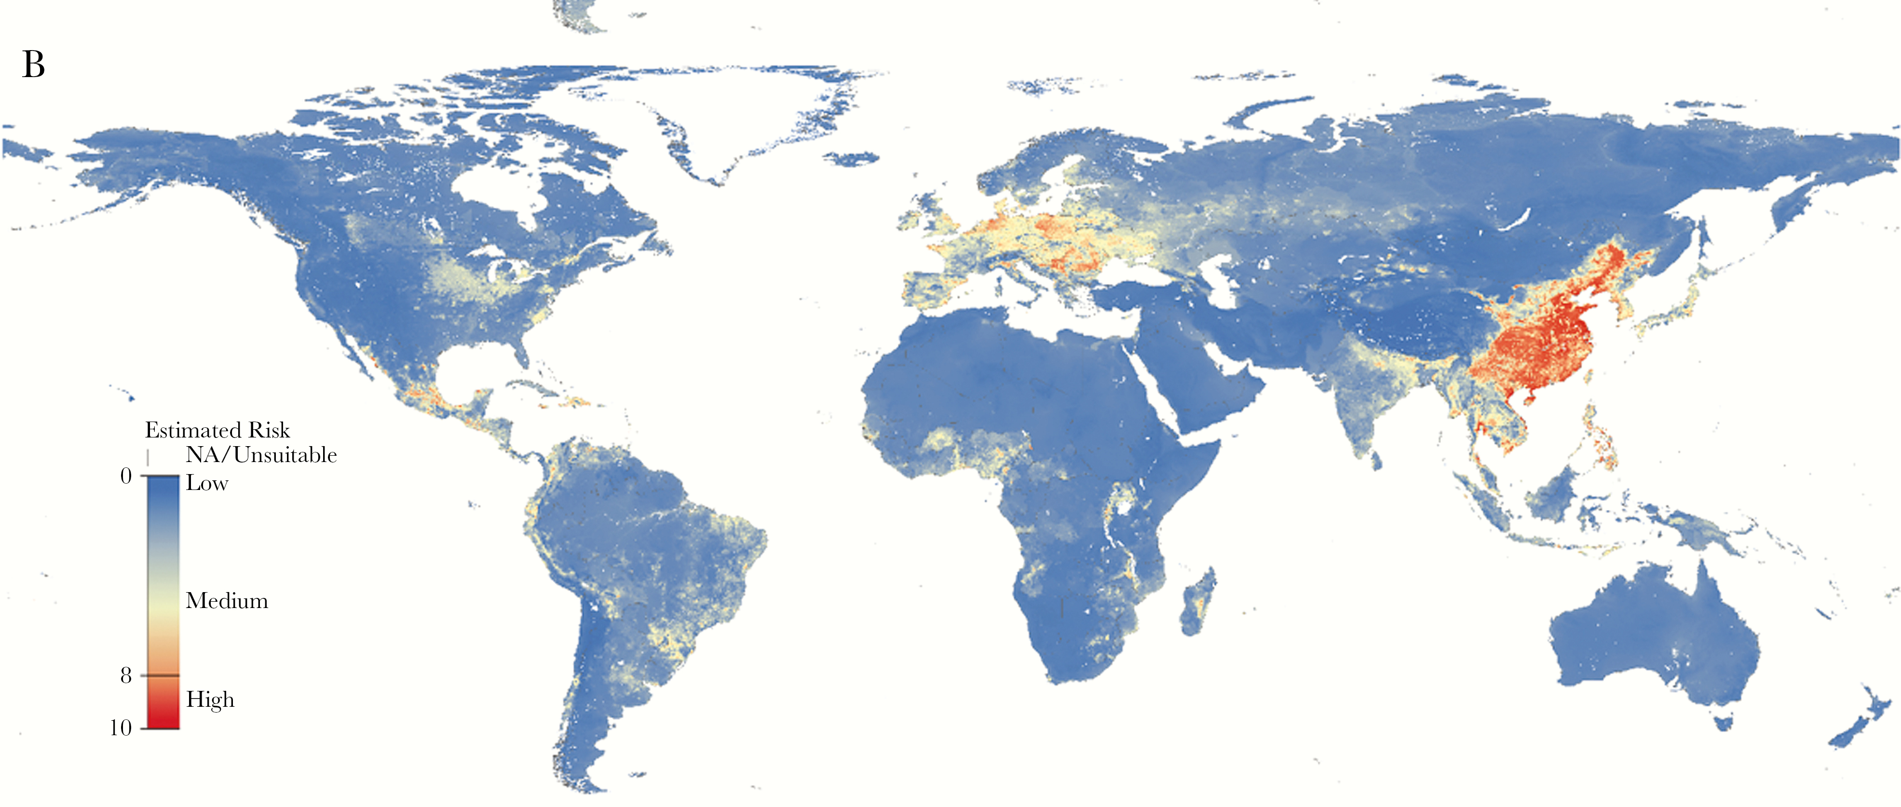
Global zoonotic surveillance (“early detection, early response”)
Top-down approaches:
Notes:
Pigs, poultry, aquatic birds need to be monitored to detect viruses well before they appear in humans.
Animals may harbor influenza viruses for a period of time before jumping into humans
Like the 1918 strain, the A H1N1 2009 pandemic precursor viruses were present in swine for long periods of time before it emerged in humans. Above, estimated risk of zoonotic disease transmission, including influenza, from pigs.
https://academic.oup.com/ofid/article/5/12/ofy318/5210928

Slide 20
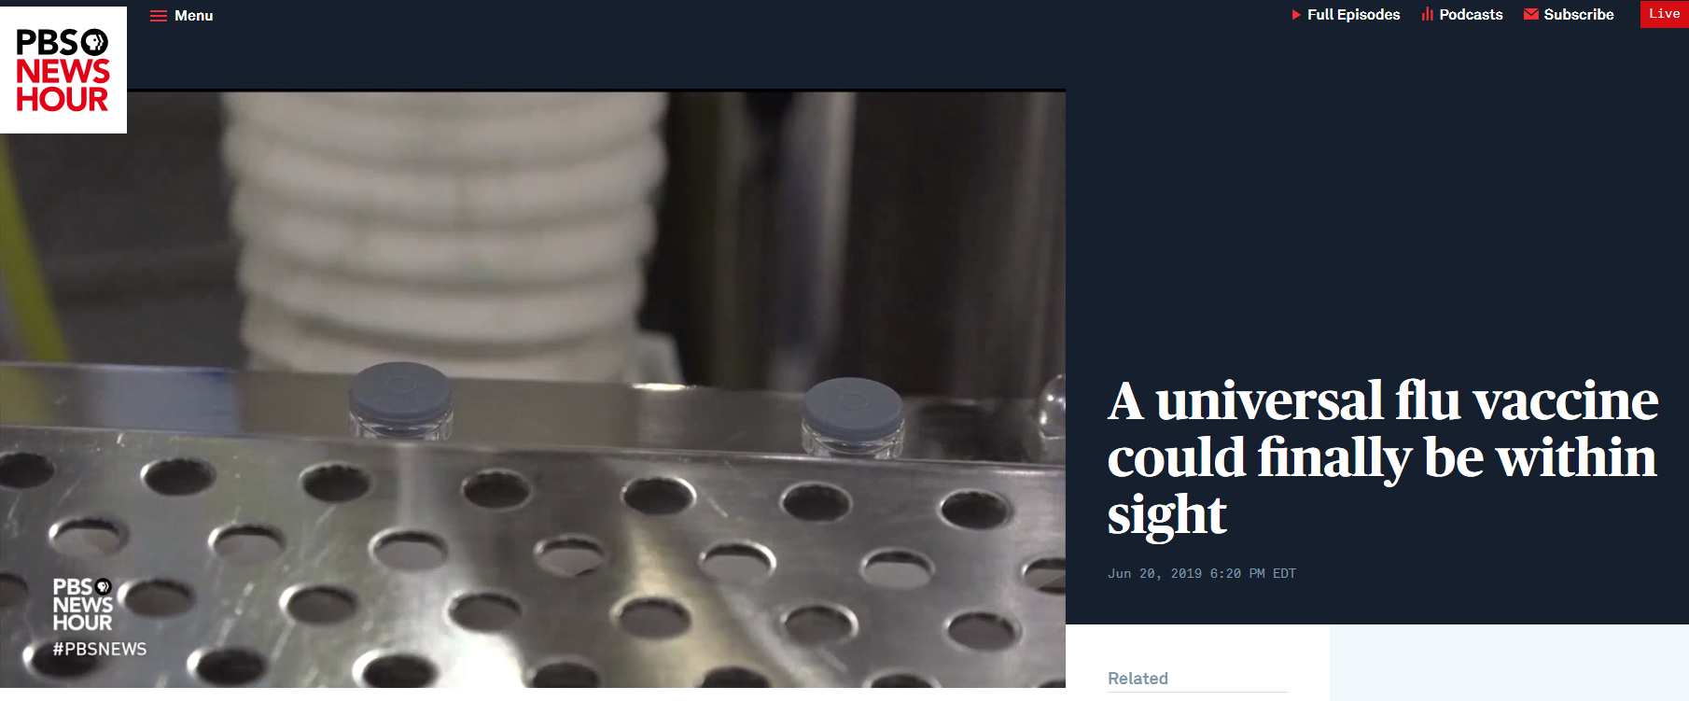
Top-down solutions: universal flu vaccine
Video
Notes:
Trials of a universal vaccine for influenza are underway as of this summer at the National Institutes of Health (NIH) Pratha Sah et al. Future epidemiological and economic impacts of universal influenza vaccines, Proceedings of the National Academy of Sciences (2019). DOI: 10.1073/pnas.1909613116
https://www.nih.gov/news-events/news-releases/nih-begins-first-human-trial-universal-influenza-vaccine-candidate
https://www.pbs.org/newshour/show/how-close-are-scientists-to-a-universal-flu-vaccine

Slide 21
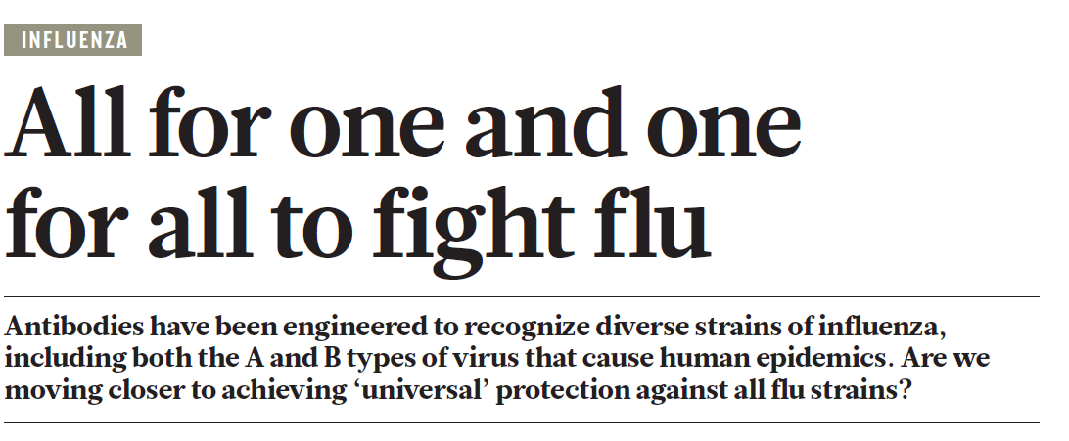
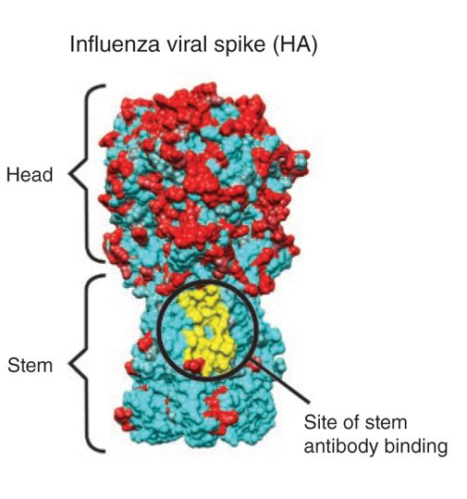
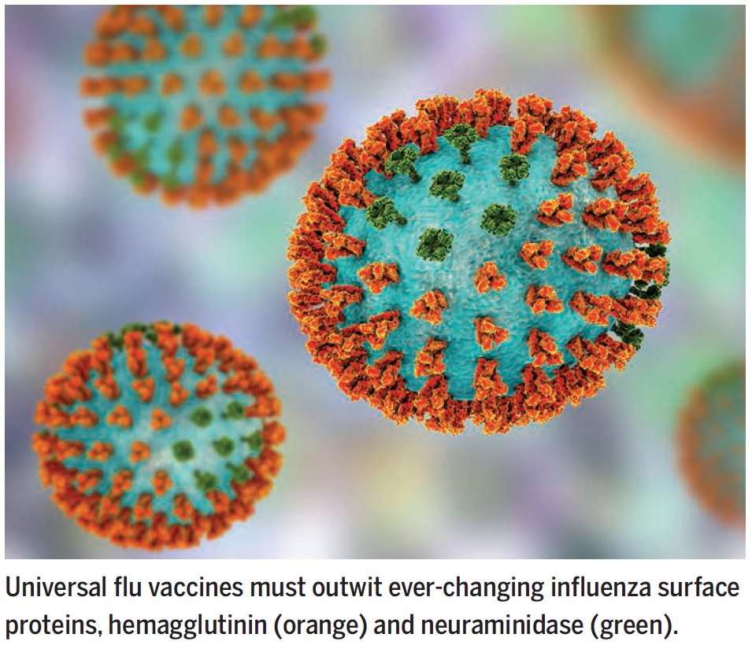
Notes:
Laursen, N. S. et al. Science 362, 598–602 (2018)
The HA proteins have a thin stalk and a rounded head, like a lollipop. The head is the part of the protein that binds to our cells, whereas the stalk contains the machinery to fuse the viral and cell membranes, making possible the transfer of genetic material. The HA head tends to be the structure our immune system — on its own or prompted by a vaccine — recognizes as an invader and for which it produces neutralizing antibodies.
The immune system normally responds to influenza virus by making neutralizing antibodies to regions of the viral spike, the hemagglutinin, that vary year to year. This natural response protects against circulating subtypes but necessitates production of new vaccines annually. Newer vaccine approaches have succeeded in eliciting broadly neutralizing antibodies to highly conserved yet vulnerable stem regions of the hemagglutinin and suggest potential pathways for the development of universal influenza vaccines.
We thought the surface of the flu virus was infinitely variable. But actually, there are some places that rarely change drastically

Slide 22
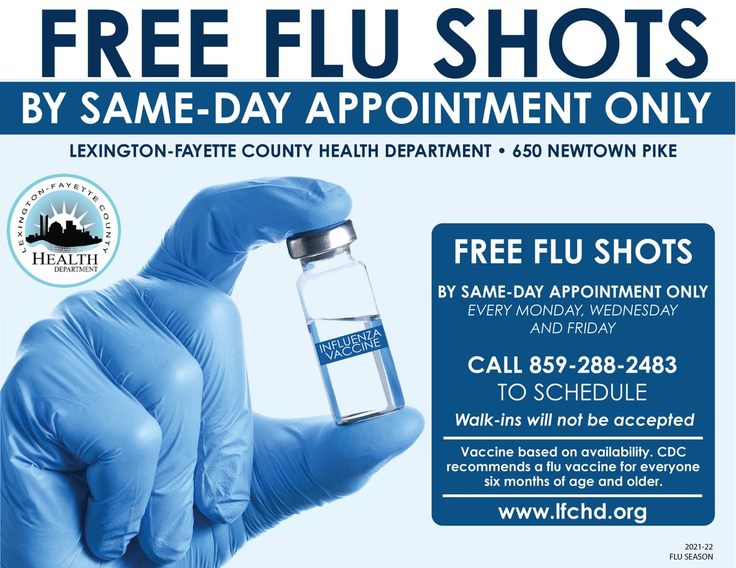
Bottom-up solutions: building preparedness at local levels
Need to build infrastructure to respond to a pandemic emergency with an everyday system that can be scaled up, not a “break-glass-in-case-of-emergency”
Making sure antiviral drugs like Tamiflu are widely available to patients with the flu
Developing better flu health awareness campaigns in local communities
Getting vaccinations to every individual
Notes:
These approaches can be critical of the big ‘moon-shot’ approaches to develop single bullet solutions. But they don’t always have to be. Both top-down and bottom-up solutions are needed.
https://www.lfchd.org/2021fluseason/

